Slide 1
How to Access McGraw-Hill ConnectED (Wonders)
1. Sign on to Classlink. https://launchpad.classlink.com/chino.
2. Click on McGraw-Hill ConnectED.
3. You will be logged in automatically. IF there is an issue, sign in using your school email address.
Email: district username@stu.chino.k12.ca.us
Password: district password
4. When you are logged in, click “Launch”.
5. The To Do list (green check mark) lists all your assignments. Be sure to check the “My Work” and “My Tests” tabs.

Slide 2
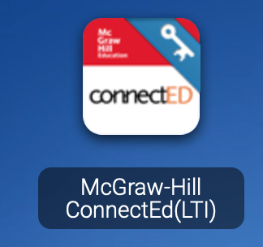
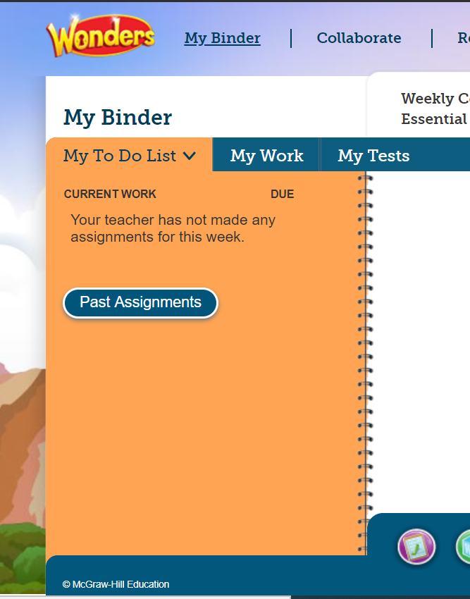
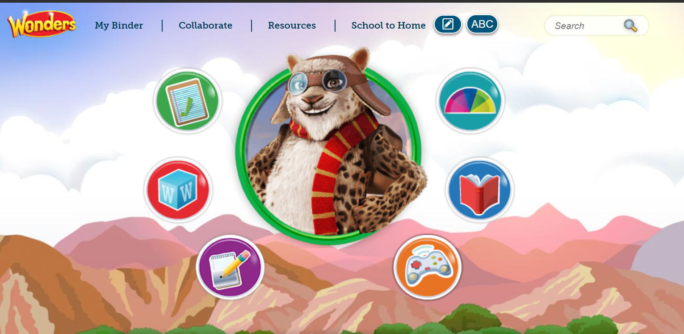
1
2
3
4

